Slide 1
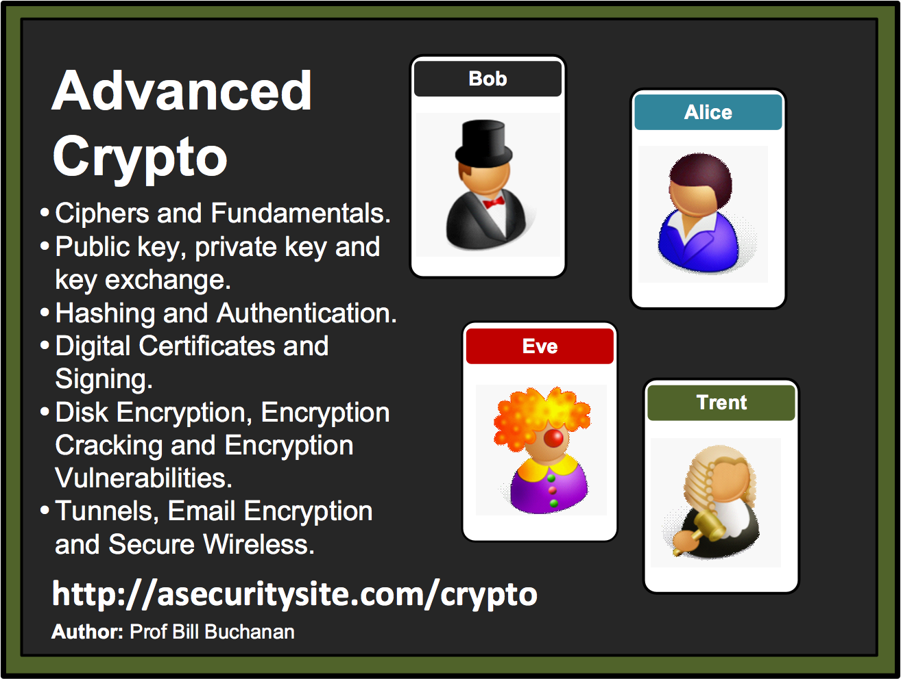

Slide 2




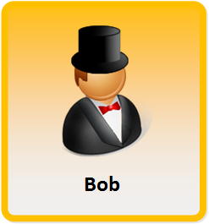
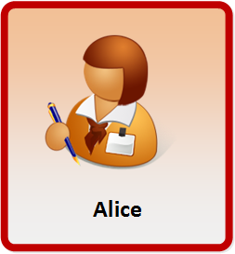



Encryption
Encryption works great, until it doesn't.
Encryption works great, as long as no one makes a mistake.
Encryption works great, unless something goes wrong.
Encryption works great, as long as everything works right.

Slide 3
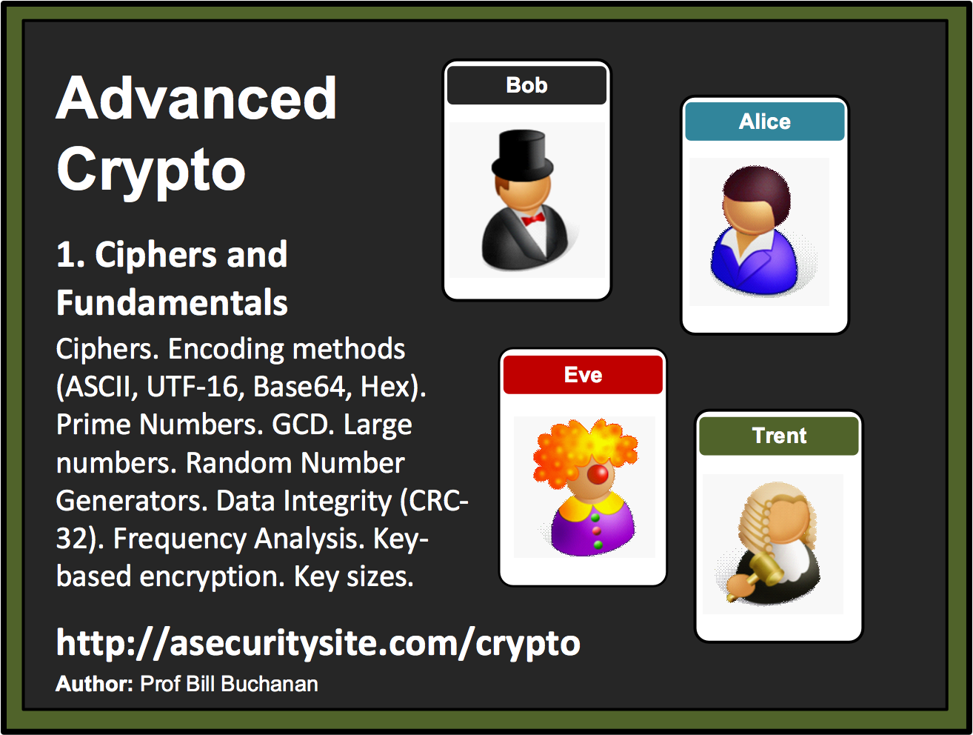

Slide 4
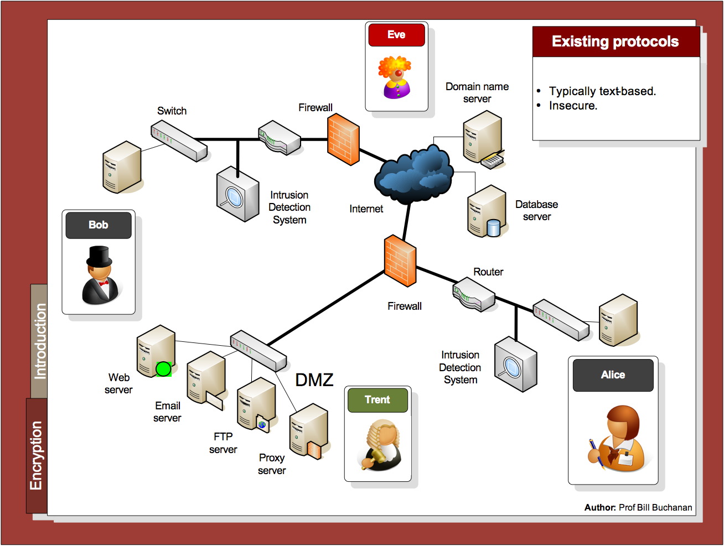

Slide 5
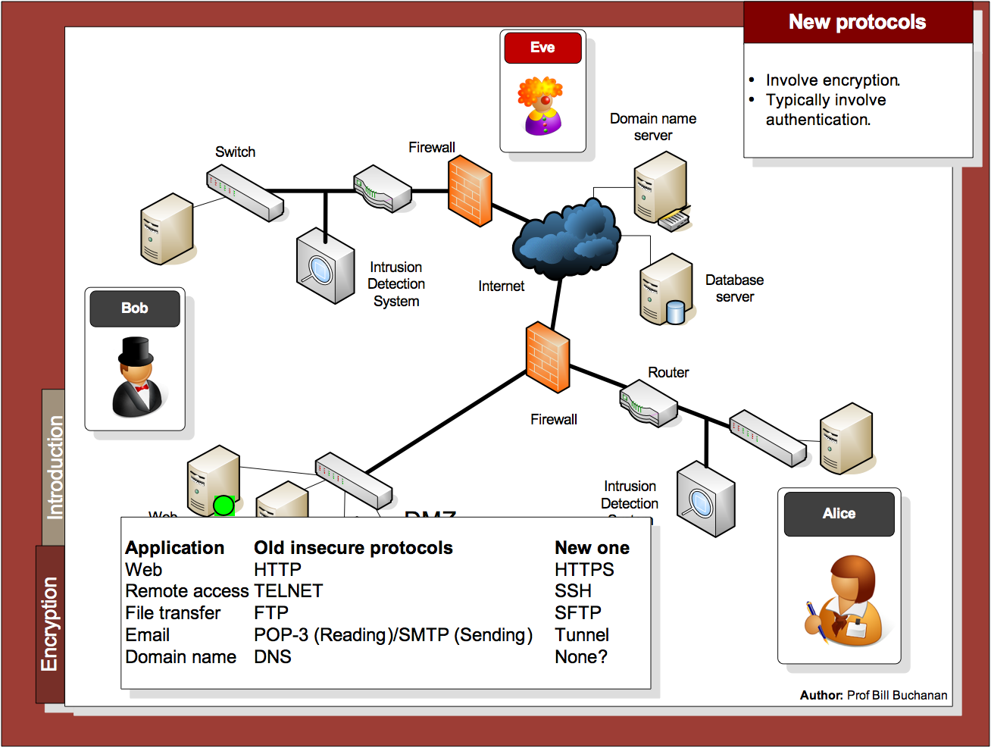

Slide 6
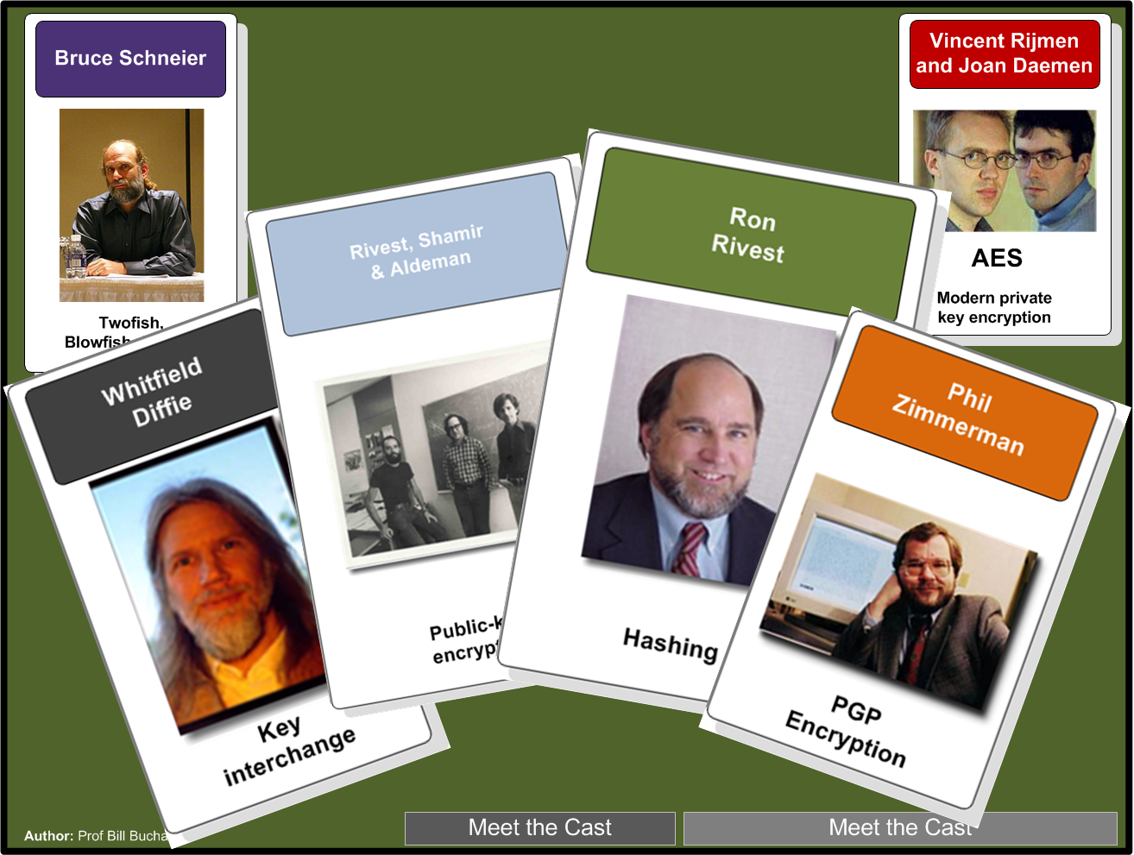

Slide 7

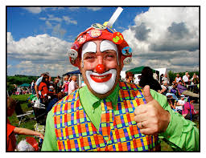
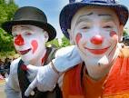
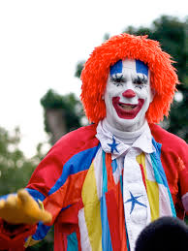

Meet the Team

Slide 8
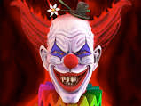


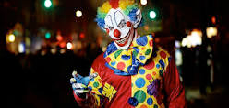
Meet the Team

Slide 9
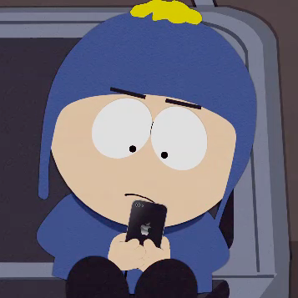

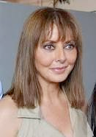
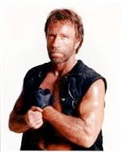
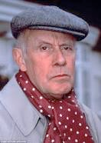
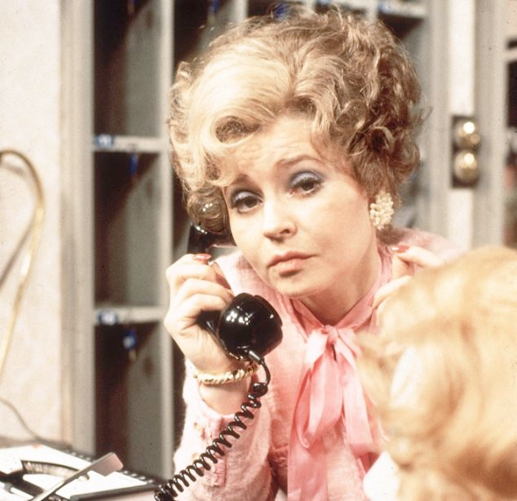


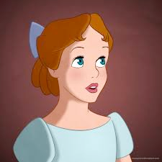
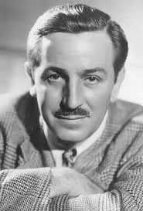

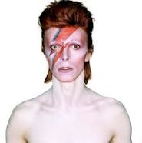

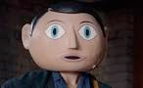
Meet the Team

Slide 10
Meet the Team
Craig, the password cracker
Carol, Carlos or Charlie, as a third participant in communications.
Oscar, an opponent
Victor. A verifier.
Chuck, as a third participant usually of malicious intent.
Peggy, a prover
Walter, a warden.
Erin, a fifth participant.
Sybil, an attacker who marshals a large number of pseudonymous identities.
Wendy, a whistleblower.
Dan, Dave or David, a fourth participant.
Frank, a sixth participant
Grace, a government representative.
Faythe, a trusted advisor, courier or intermediary.

Slide 11
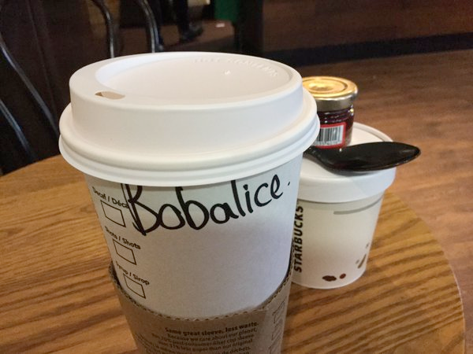
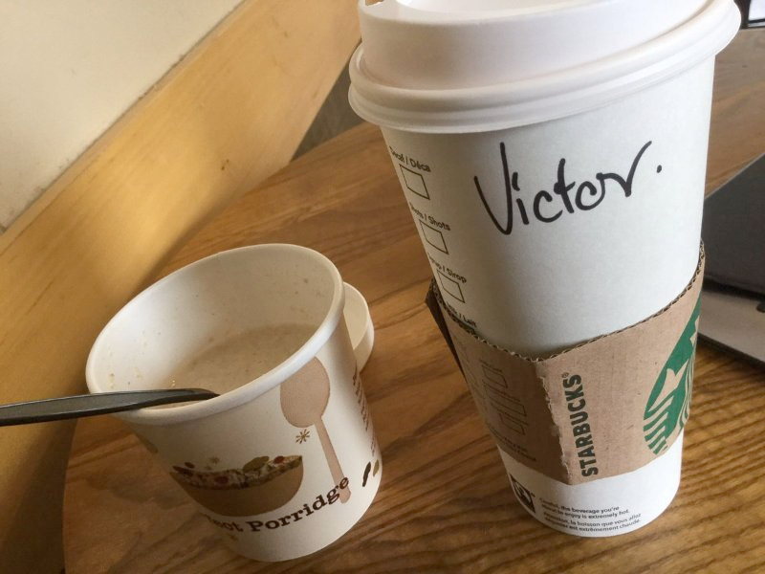
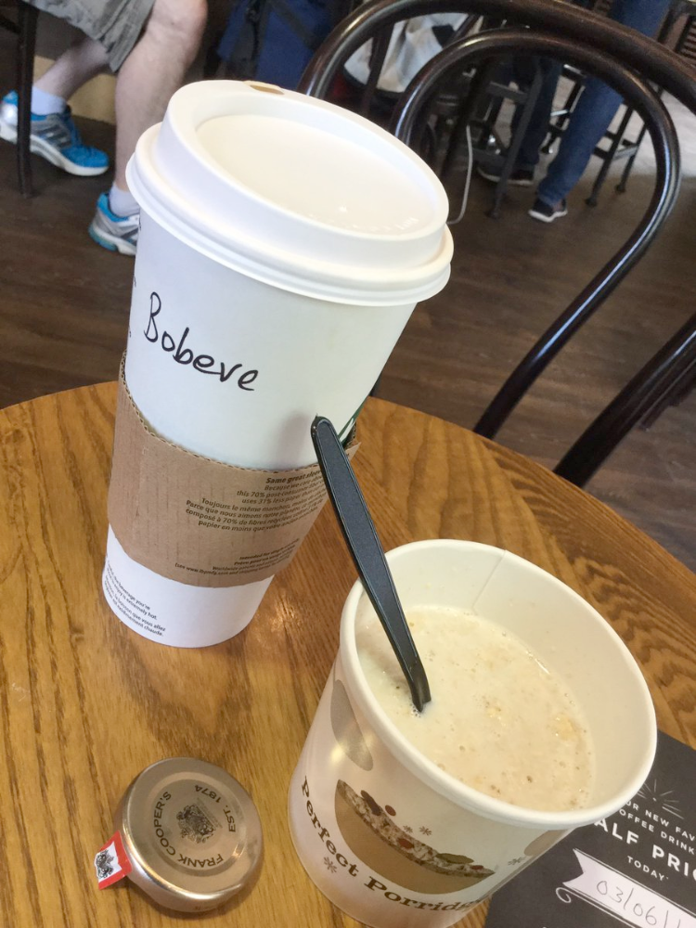
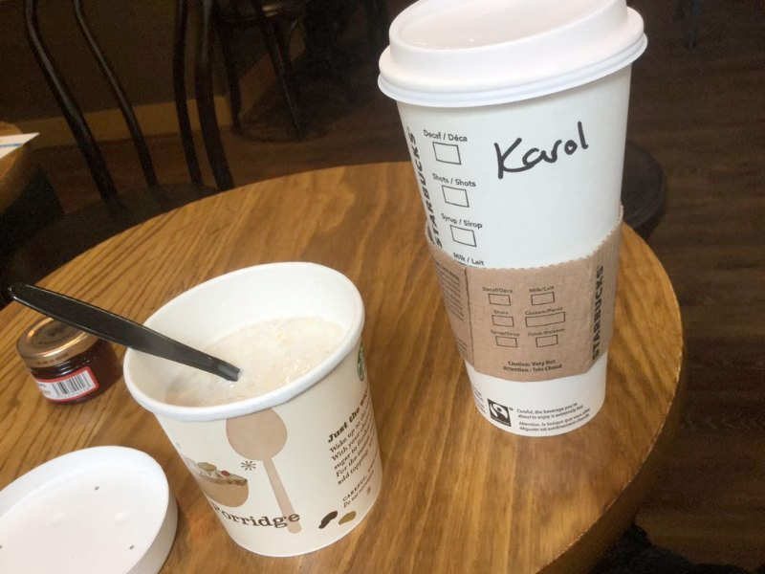
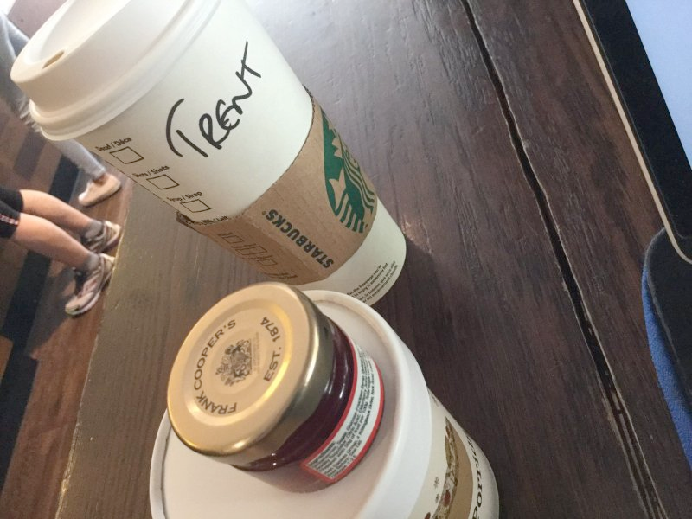

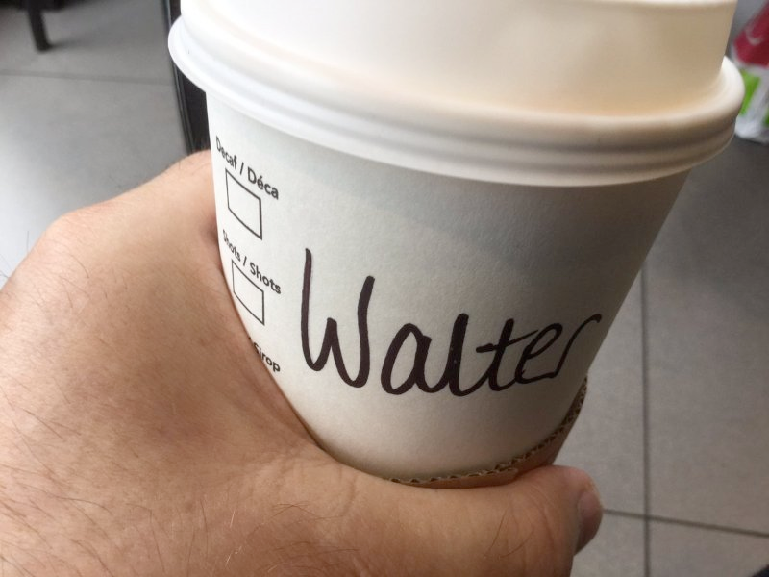
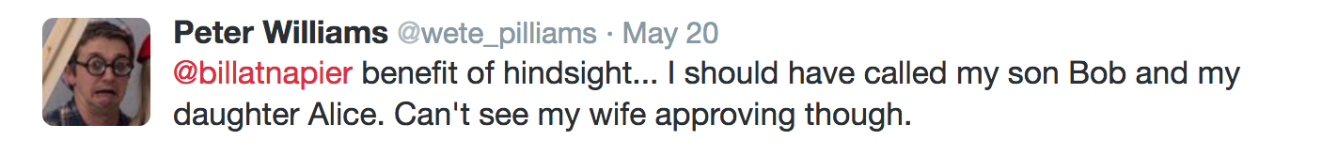
Meet the Team
Craig, the password cracker
Carol, Carlos or Charlie, as a third participant in communications.
Oscar, an opponent
Victor. A verifier.
Chuck, as a third participant usually of malicious intent.
Peggy, a prover
Walter, a warden.
Erin, a fifth participant.
Sybil, an attacker who marshals a large number of pseudonymous identities.
Wendy, a whistleblower.
Dan, Dave or David, a fourth participant.
Frank, a sixth participant
Grace, a government representative.
Faythe, a trusted advisor, courier or intermediary.

Slide 12
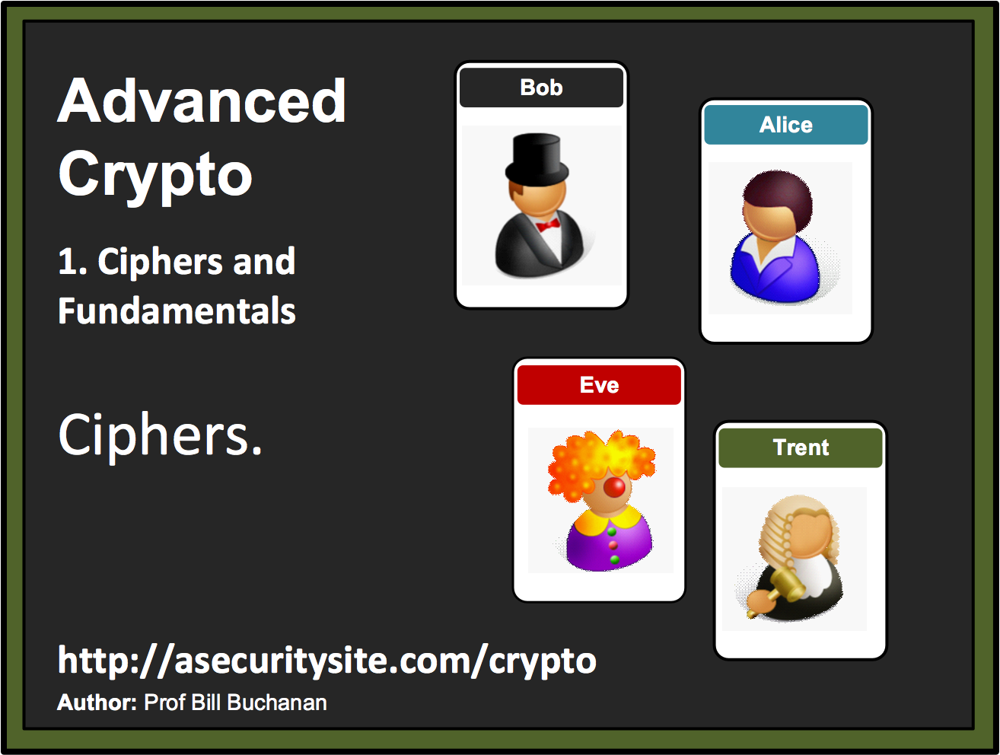

Slide 13
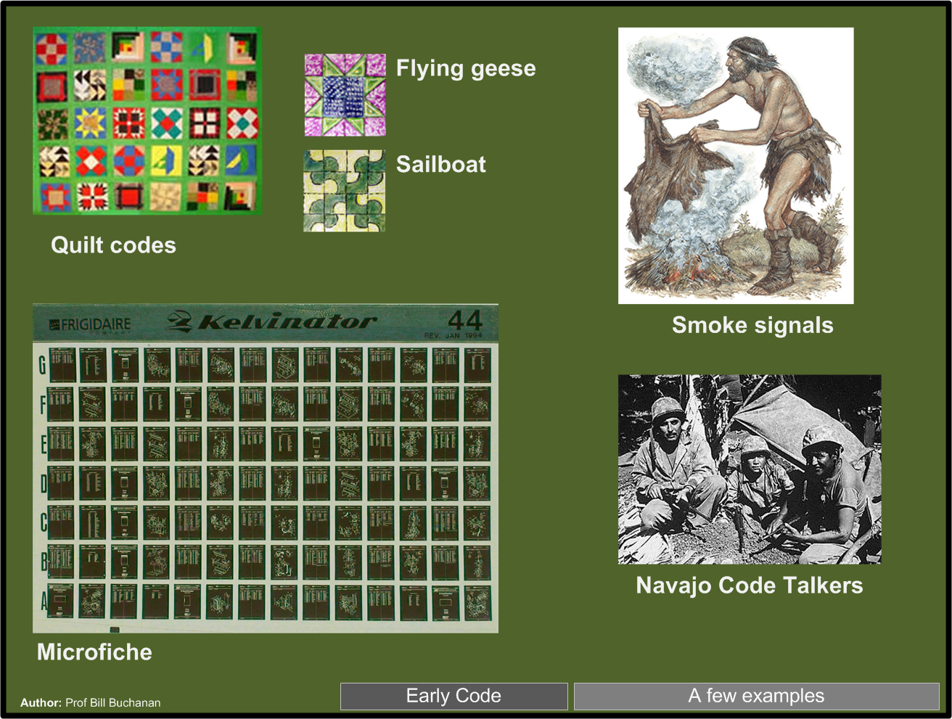

Slide 14
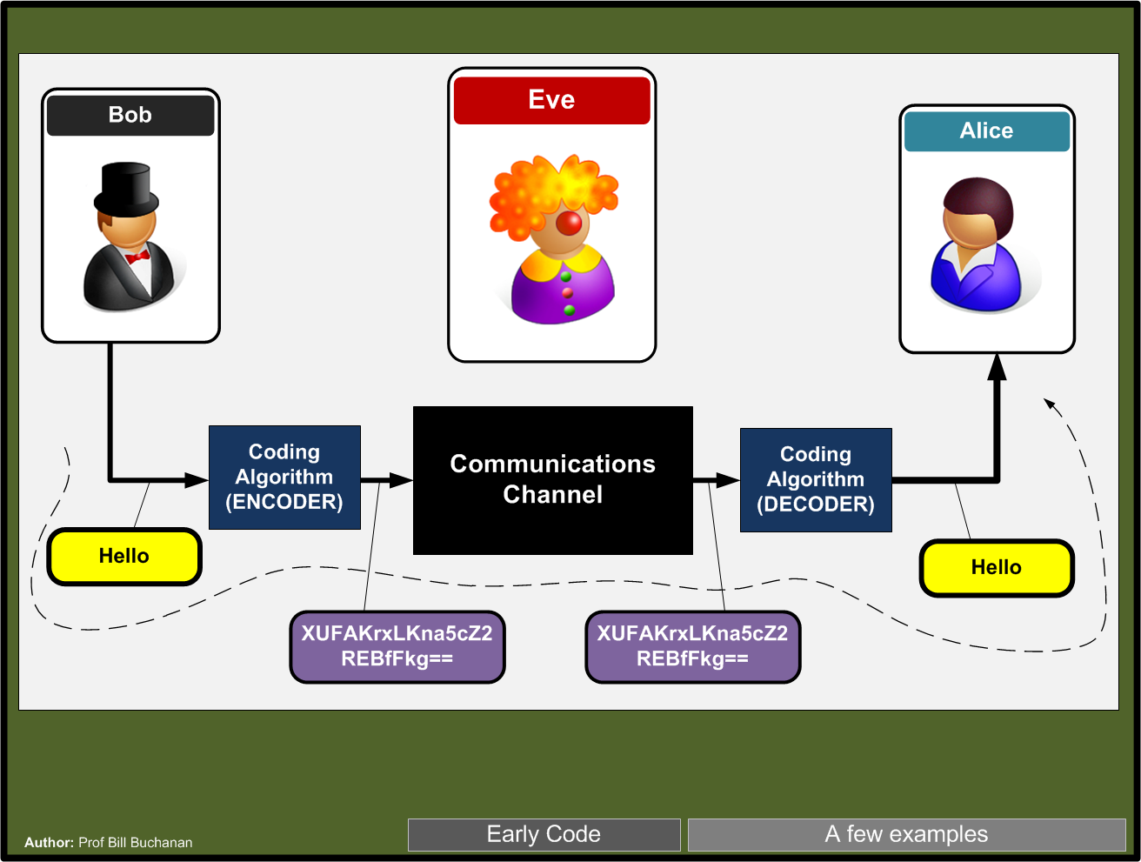

Slide 15
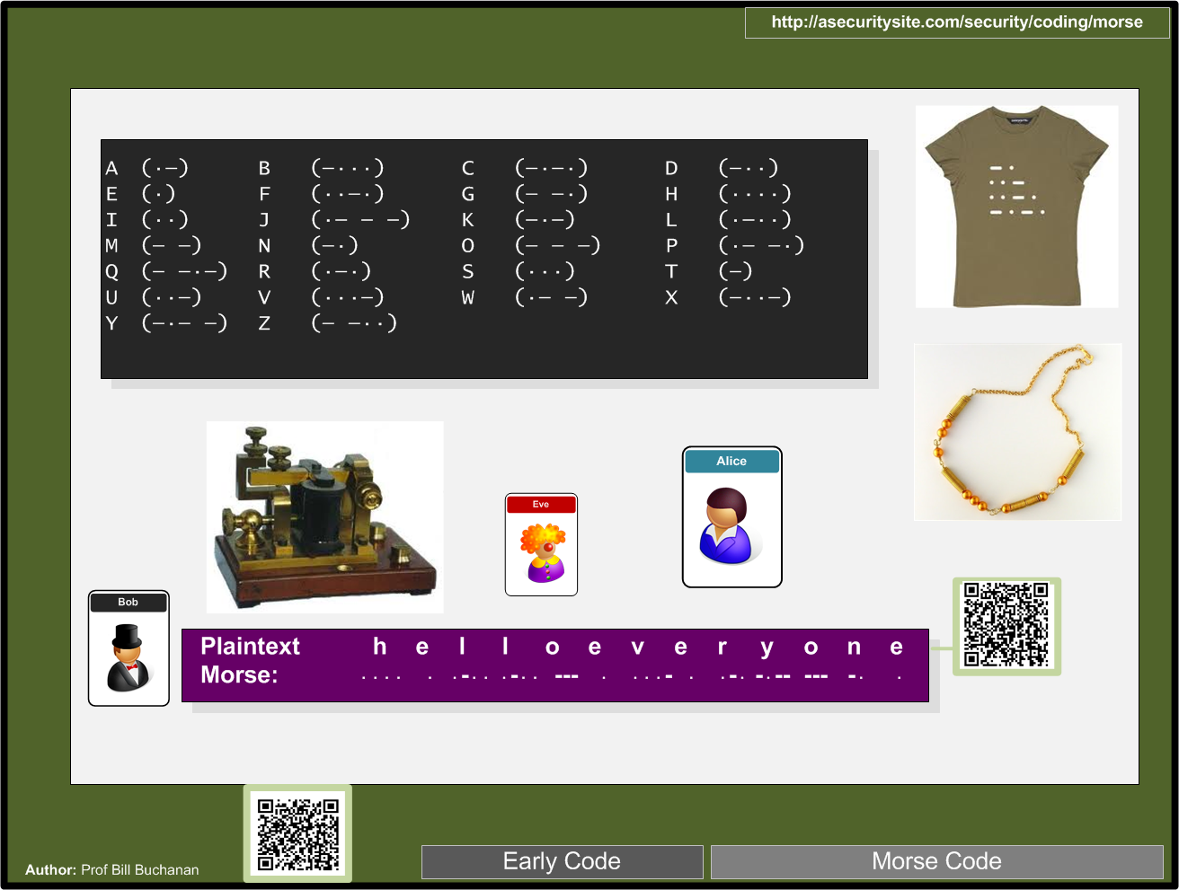

Slide 16
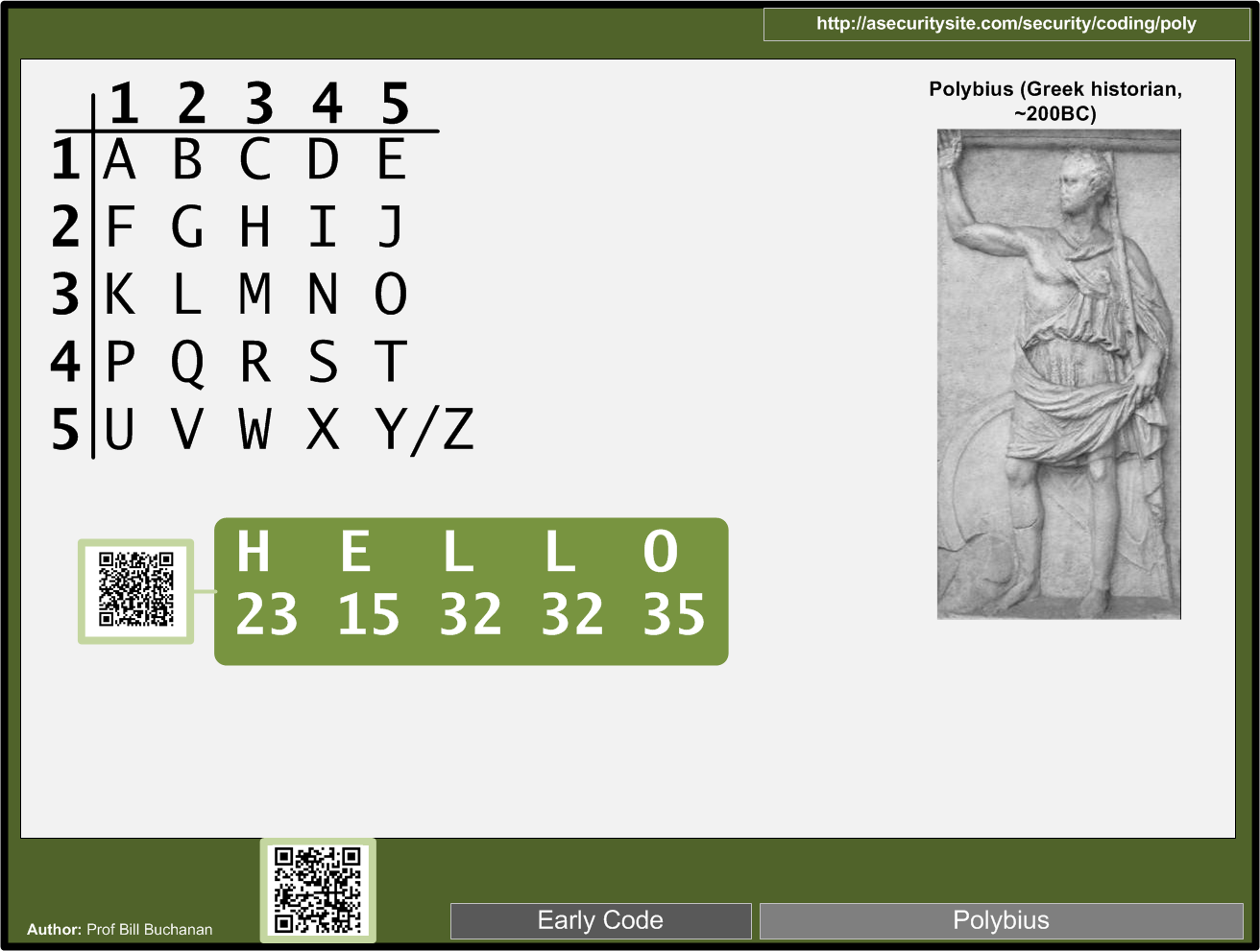

Slide 17
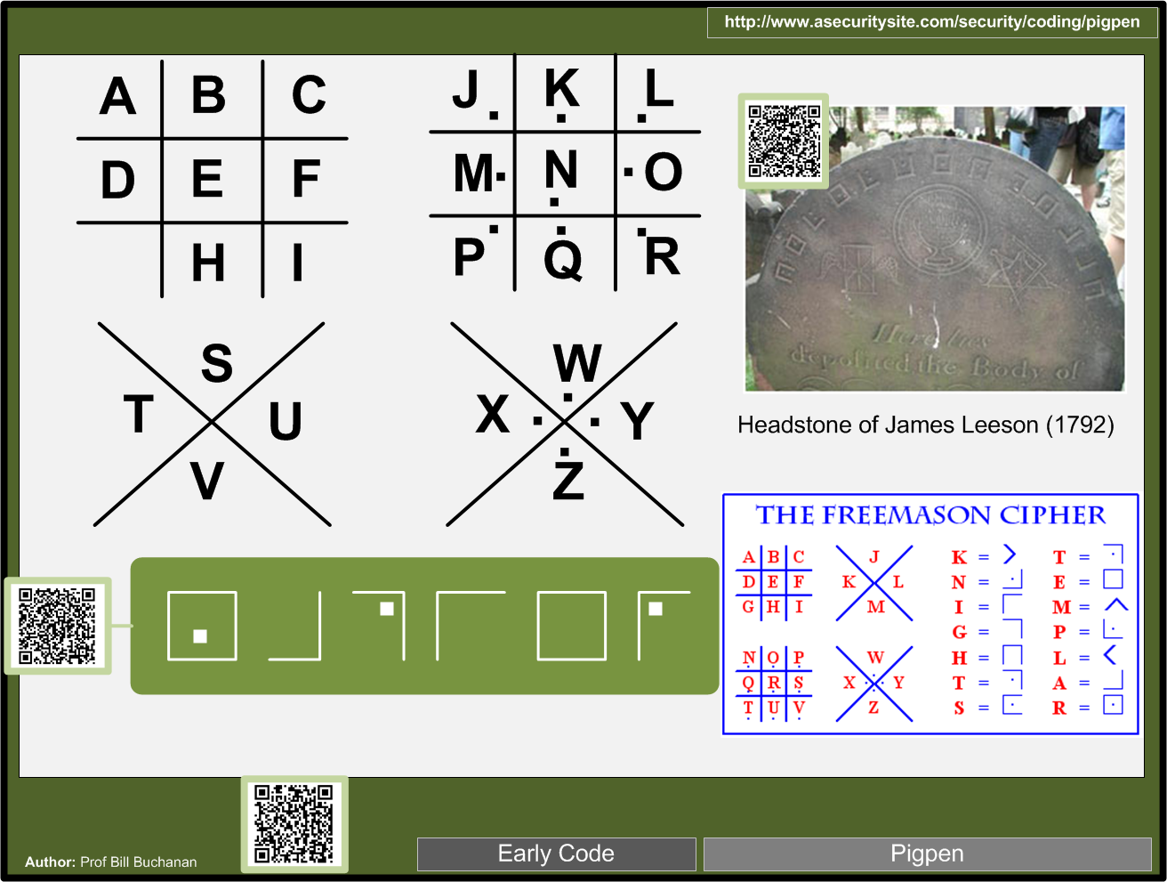

Slide 18
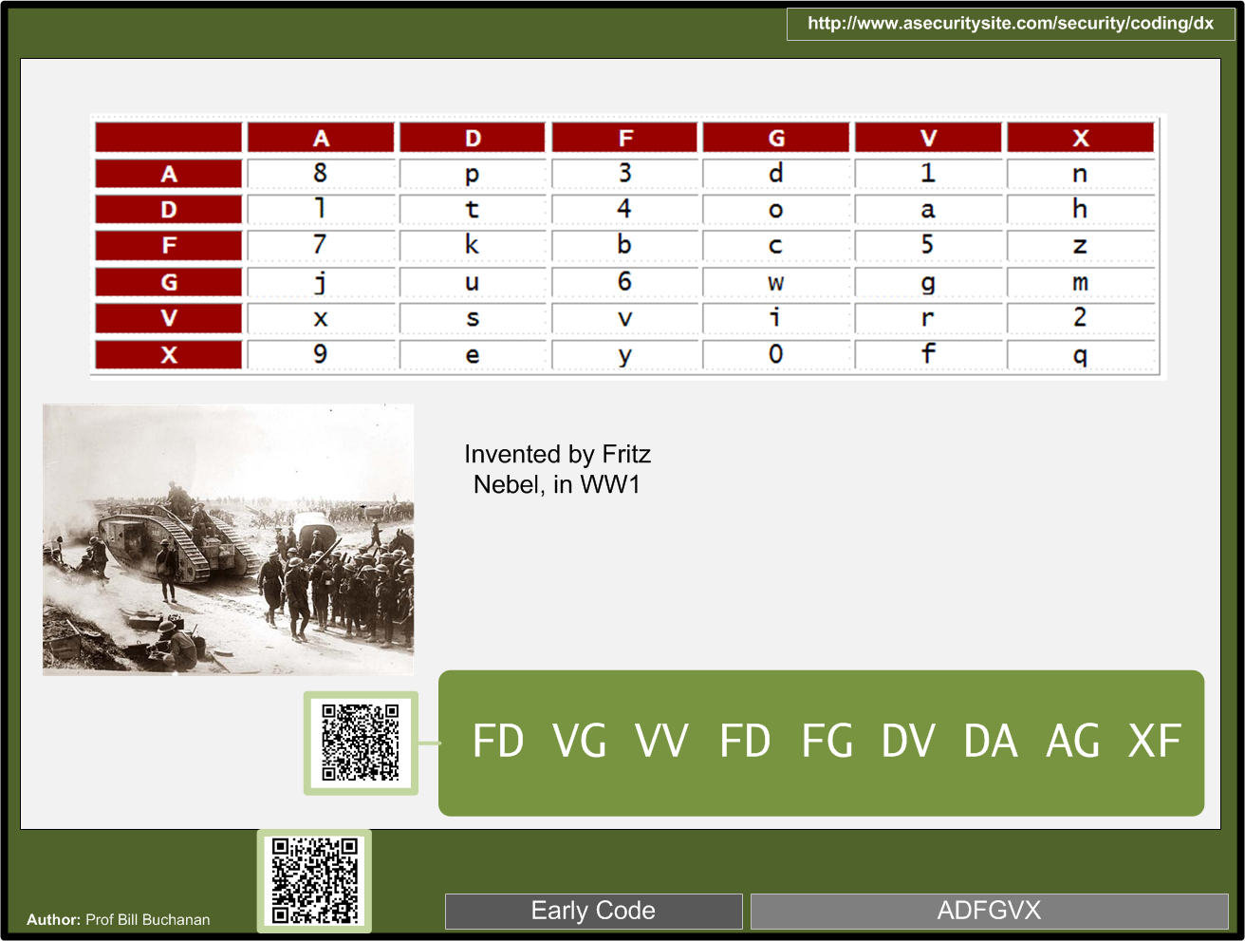

Slide 19
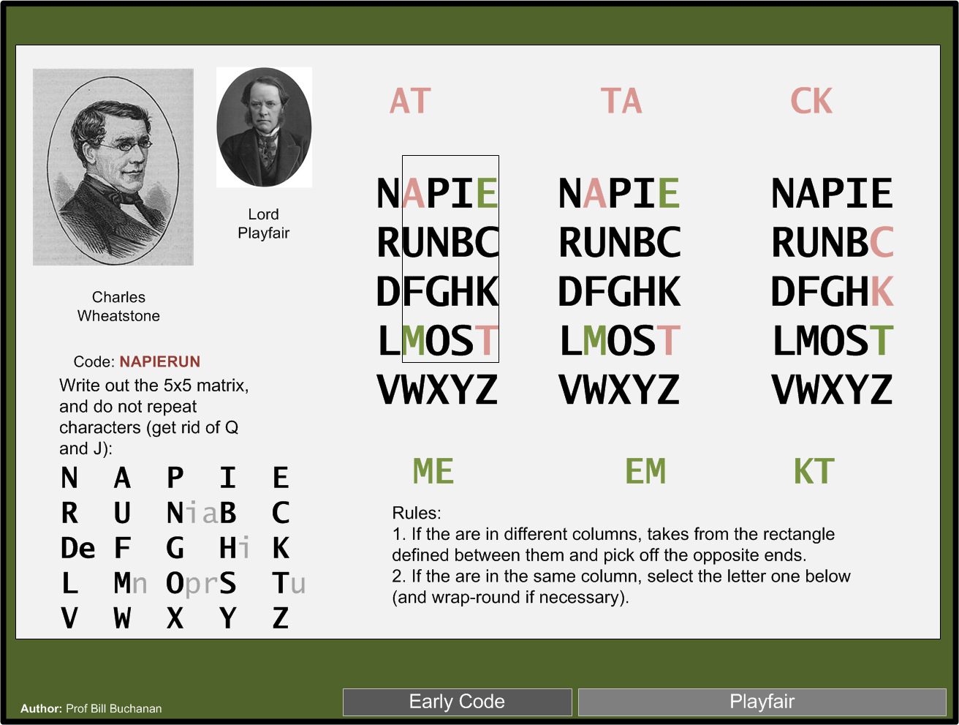

Slide 20

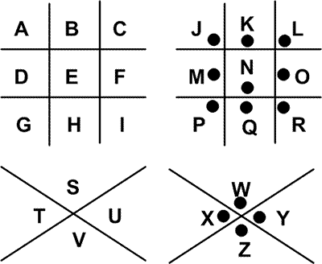
What is
starting
foxtrot
inverts
inkwell

Slide 21
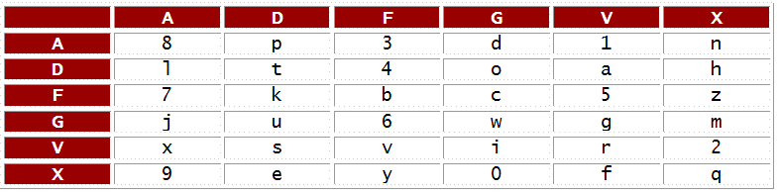
What is DADGDDDXVGDVAX
lighter
listens
lothian
likelier

Slide 22

With Playfair, what will “HE” be coded as:
IK
KI
DN
ND
PL

Slide 23
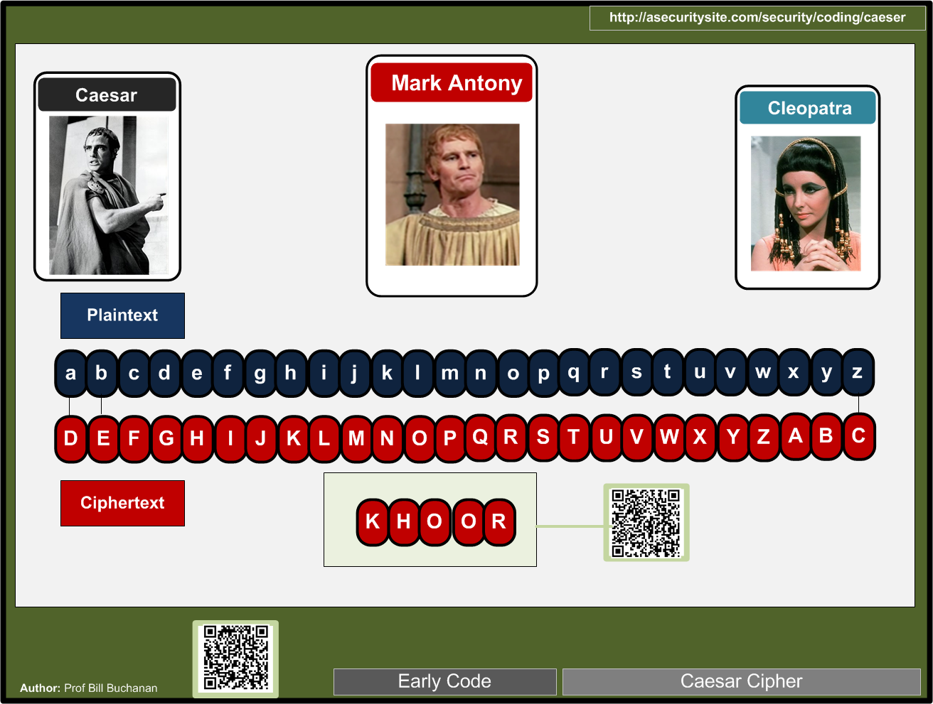

Slide 24
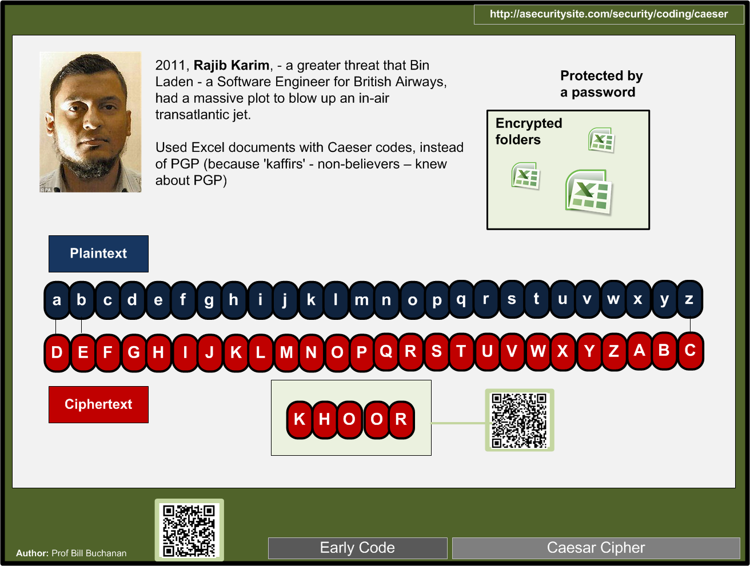

Slide 25
With Caesar Code, how many codes are uniquely possible?
24
25
26
256

Slide 26

What was the plain text for the message
apple
hello
ankle
solid

Slide 27
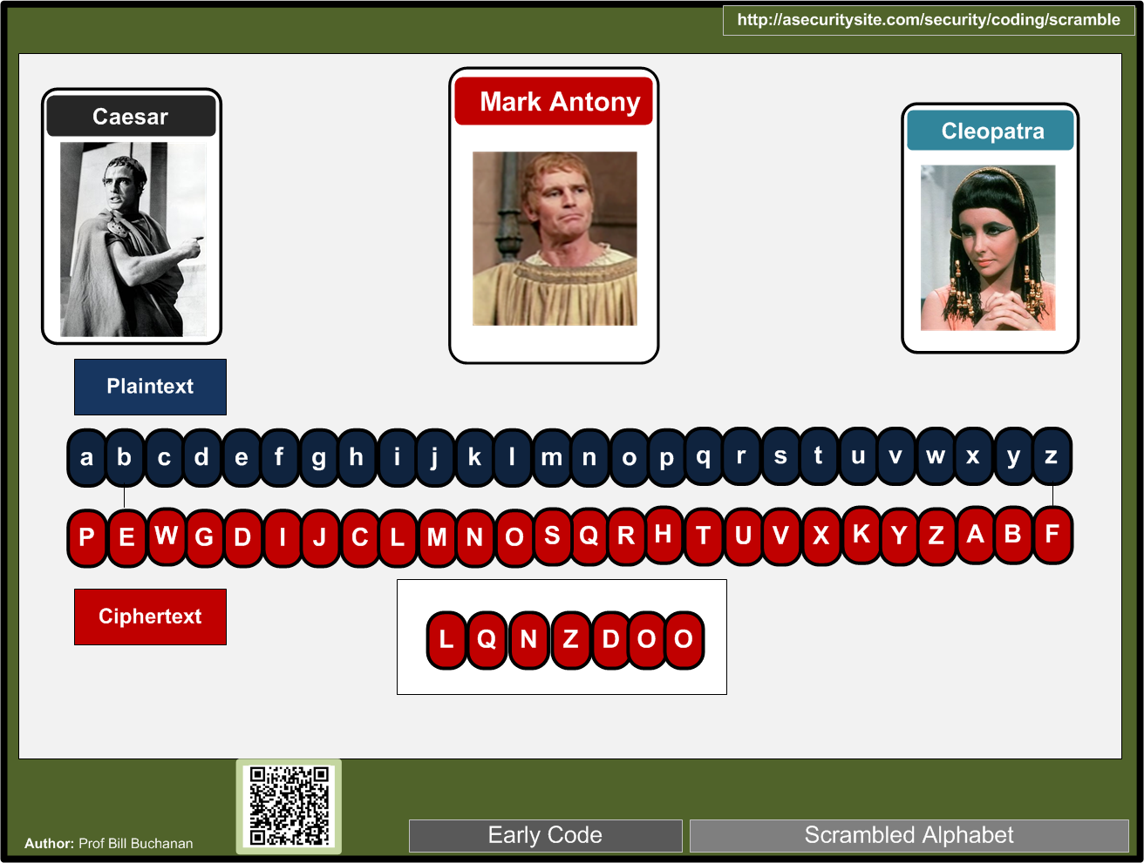

Slide 28
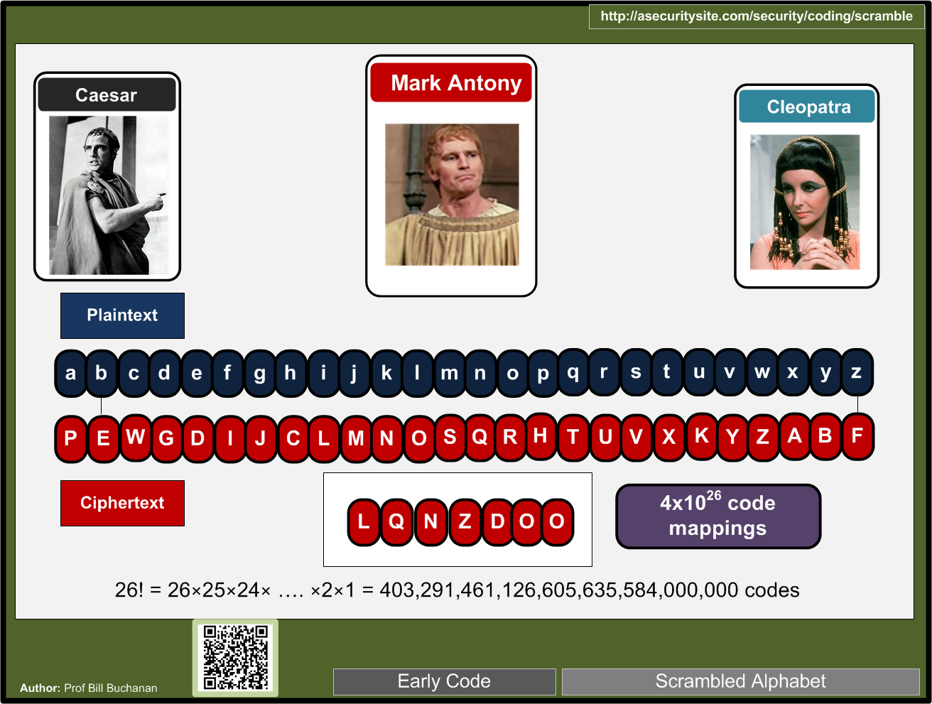

Slide 29
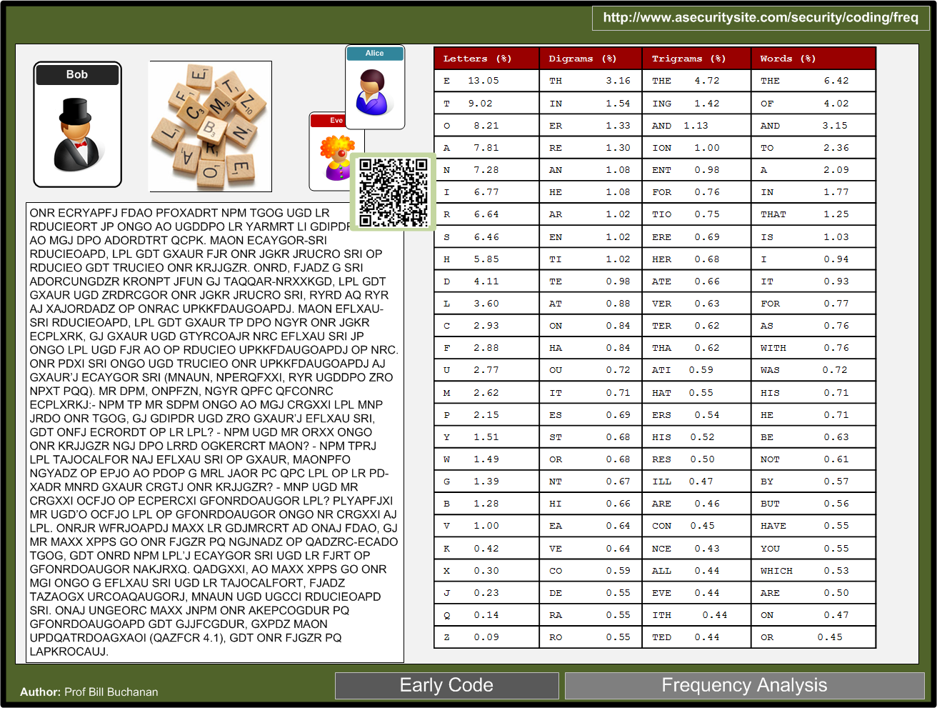

Slide 30
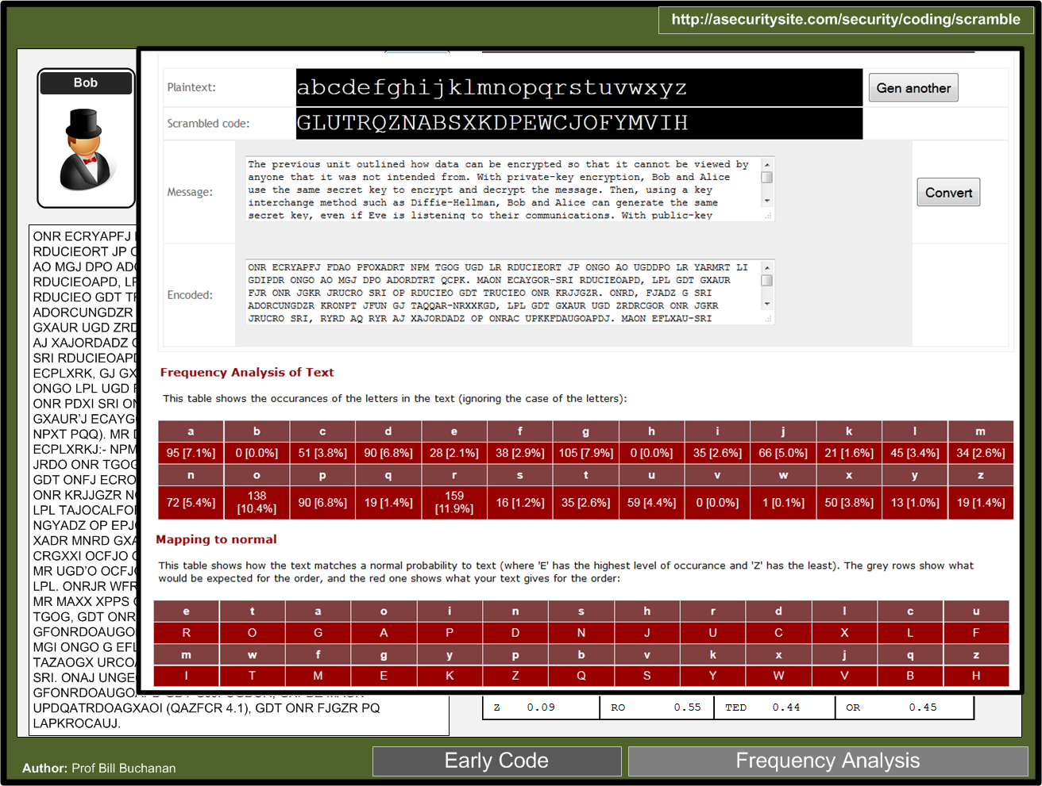

Slide 31
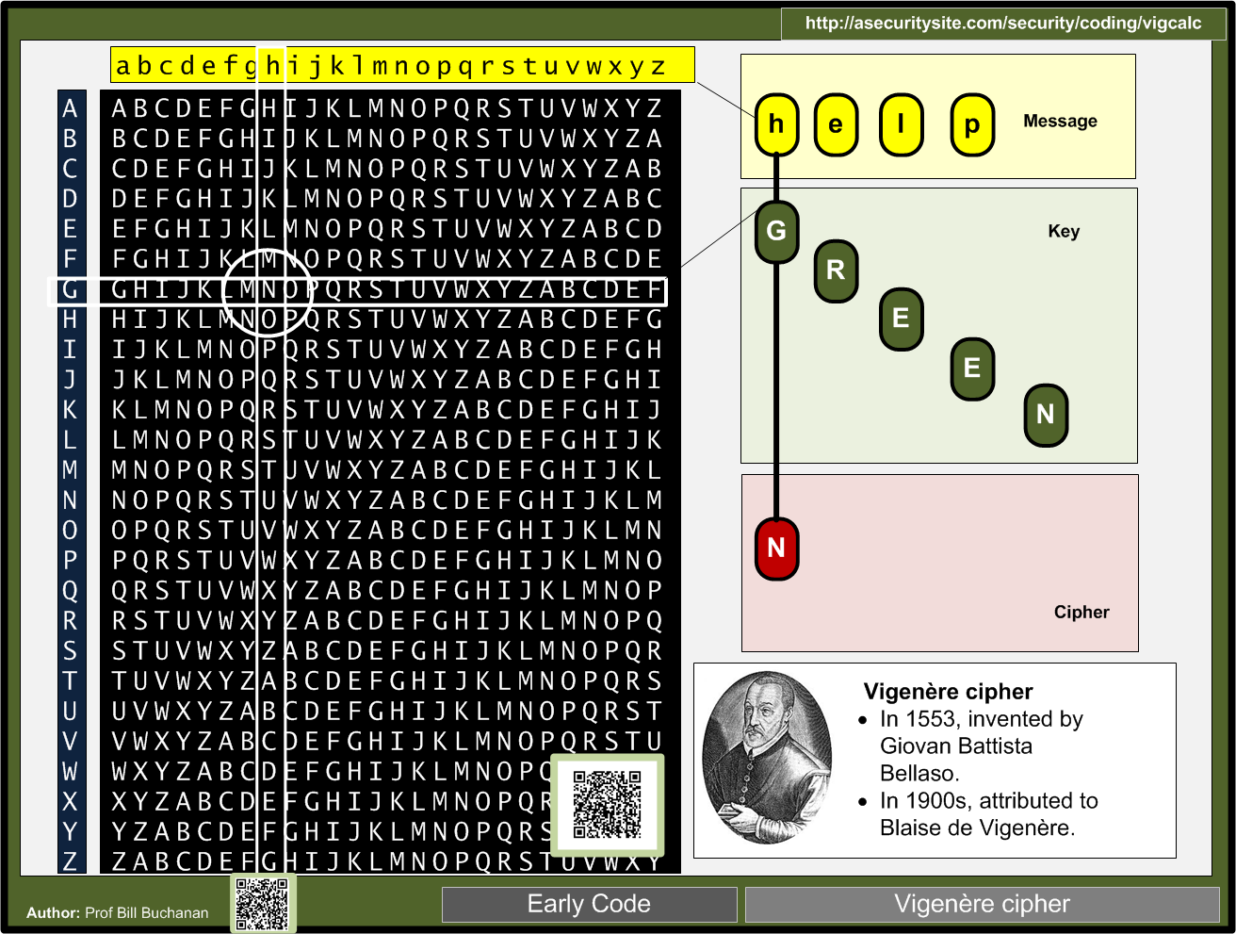

Slide 32
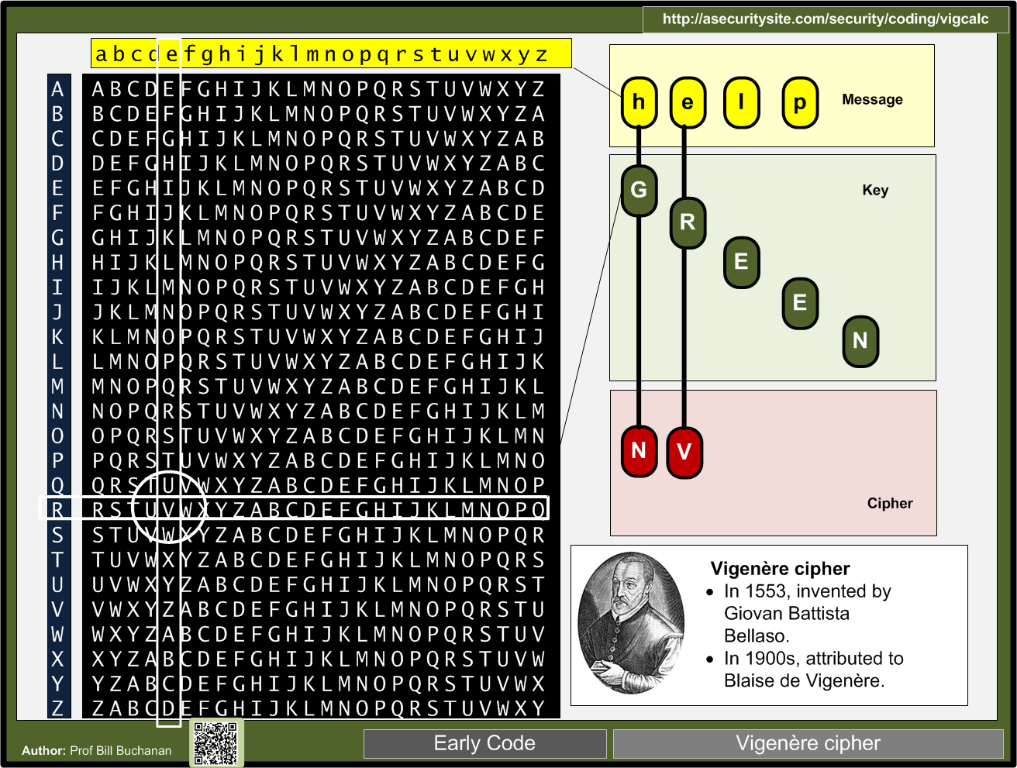

Slide 33
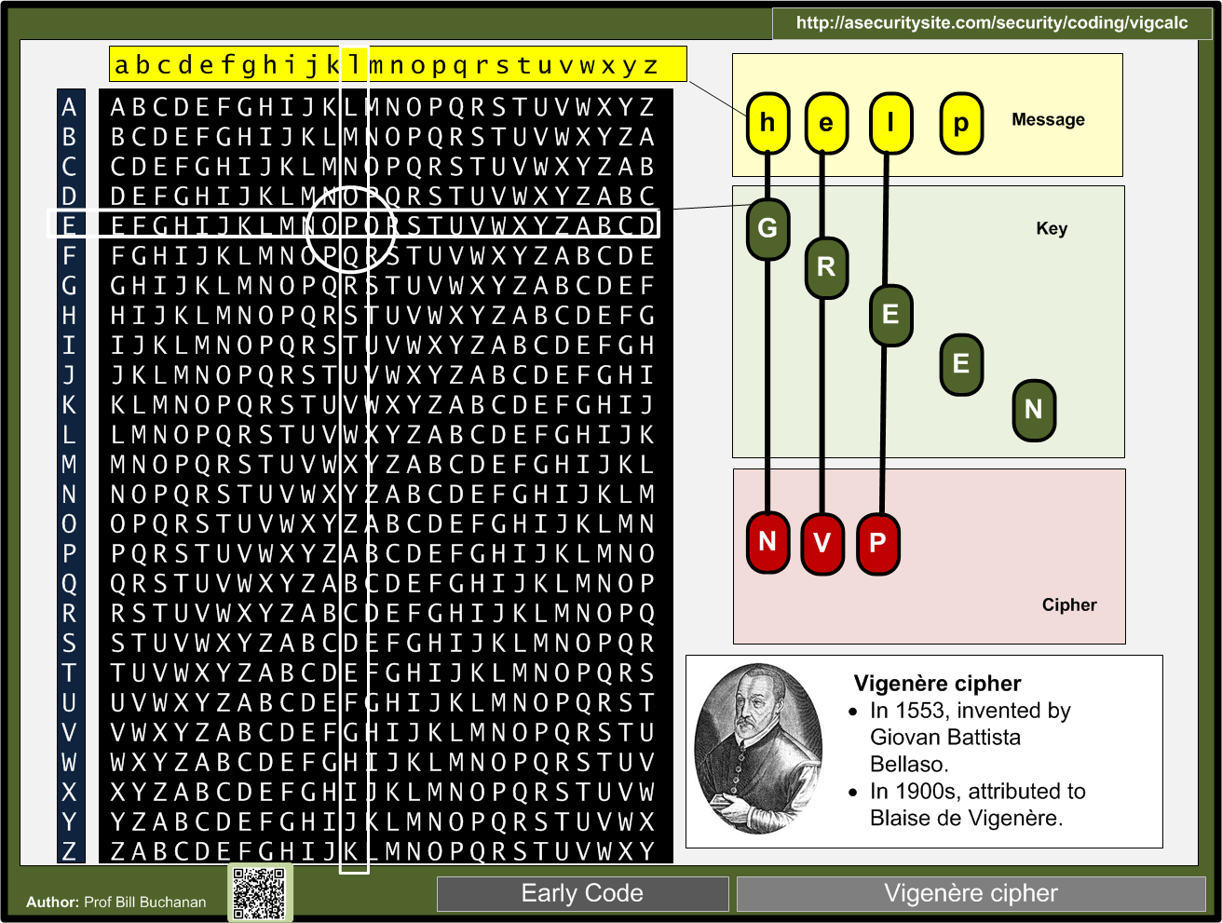

Slide 34
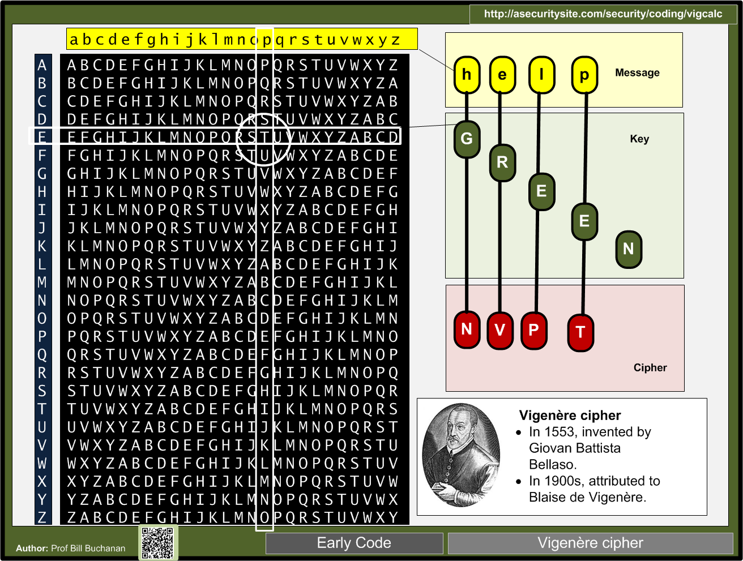

Slide 35
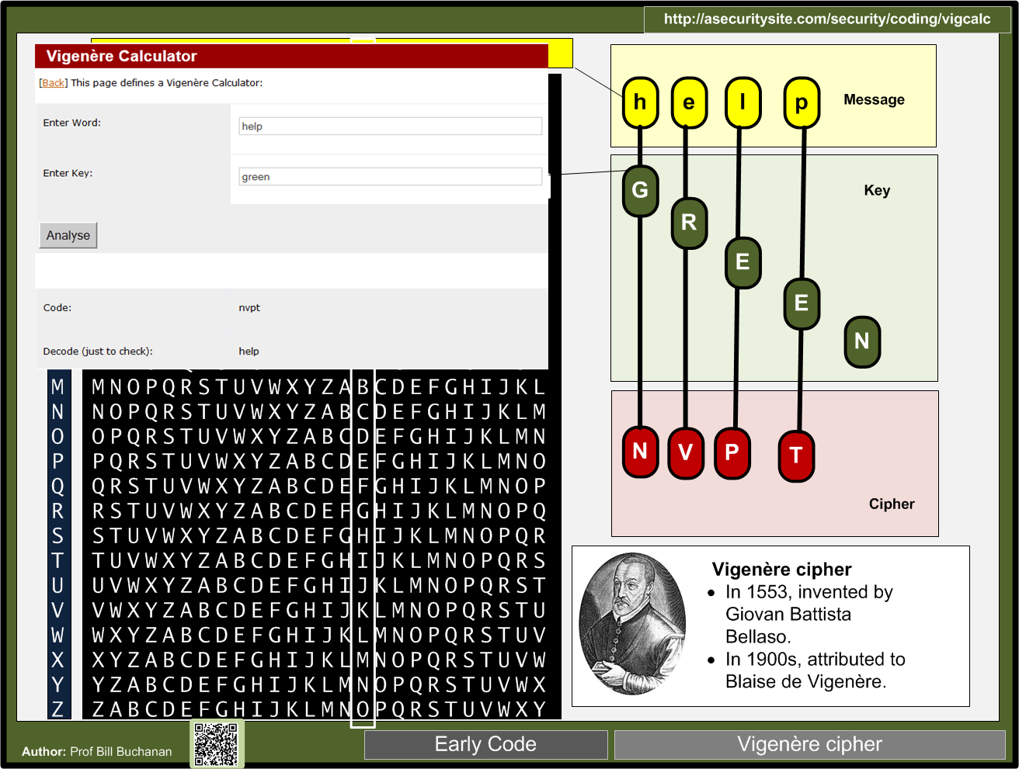

Slide 36
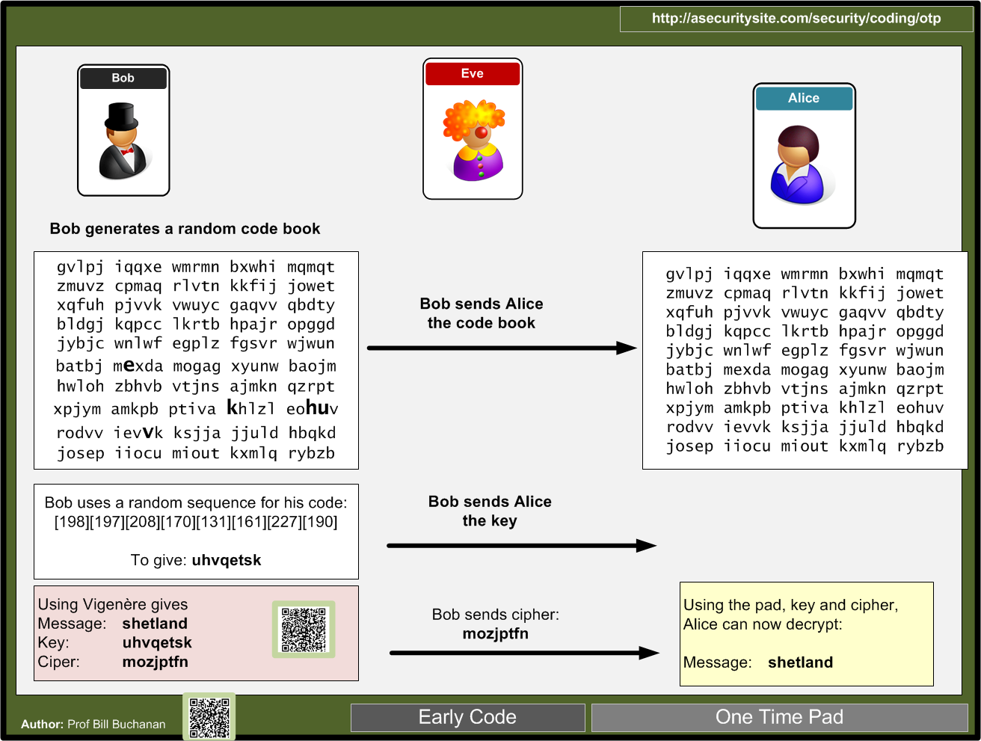

Slide 37


Slide 38


Slide 39


Slide 40


Slide 41


Slide 42


Slide 43


Slide 44


Slide 45


Slide 46


Slide 47


Slide 48


Slide 49


Slide 50


Slide 51


Slide 52


Slide 53


Slide 54


Slide 55


Slide 56


Slide 57


